Slide 1
Design and Analysis of Algorithms
CS345A
Lecture 38
How to handle NP-complete problems

Slide 2
How to handle NP-complete Problems
Approximation Algorithms

Slide 3
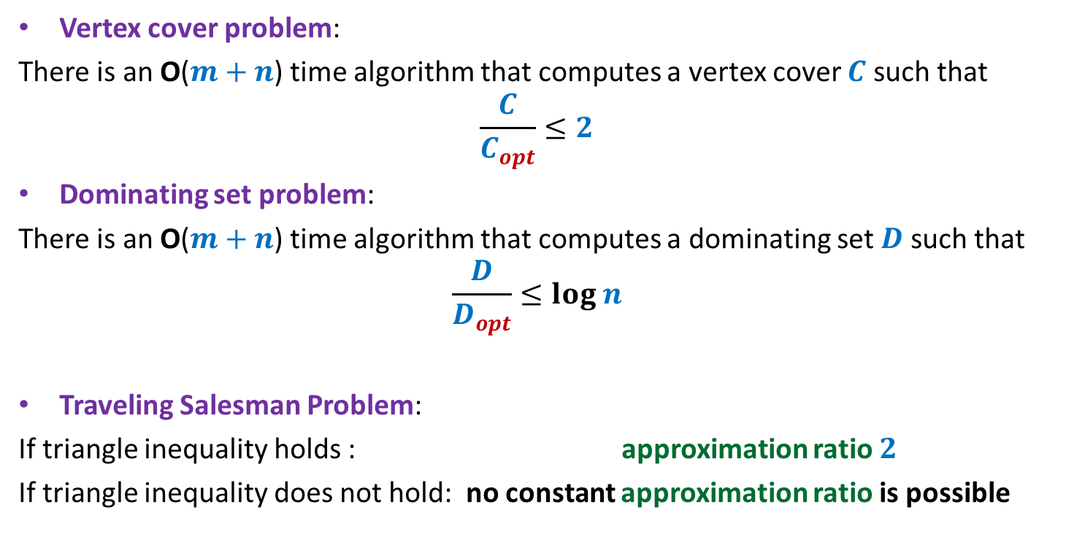
Approximation algorithms
Vertex cover problem:
There is an O($m+n$) time algorithm that computes a vertex cover $C$ such that
$$\frac{C}{C_{opt}}≤2$$
Dominating set problem:
There is an O($m+n$) time algorithm that computes a dominating set $D$ such that
$$\frac{D}{D_{opt}}≤log n$$
Traveling Salesman Problem:
If triangle inequality holds : approximation ratio $2$
If triangle inequality does not hold: no constant approximation ratio is possible

Slide 4
Vertex Cover Problem
2-Approximate algorithm

Slide 5

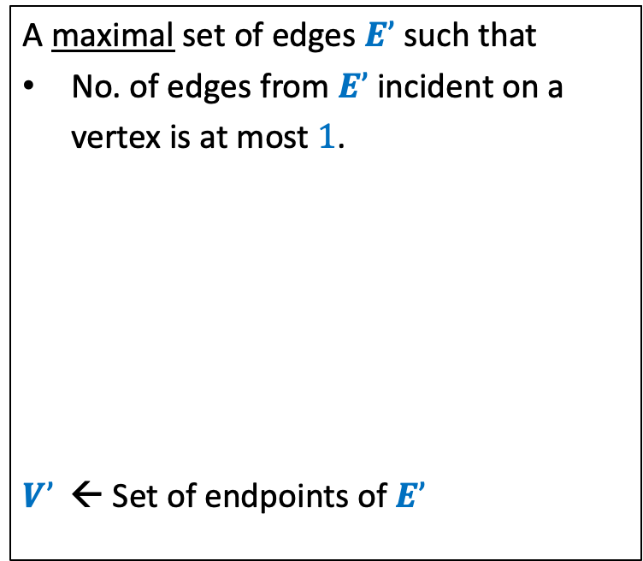

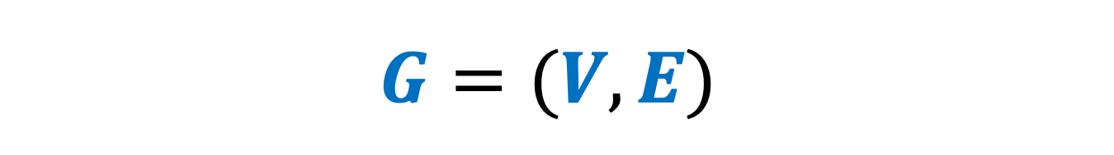



$$G=(V,E)$$
Vertex Cover
Maximal Matching
A set of vertices that cover all edges.
A maximal set of edges $E’$such that
No. of edges from $E’$incident on a
vertex is at most $1$.
$V’$ ← Set of endpoints of $E’$
…
…
$$x$$
$$y$$
$$x$$
$$y$$
$V’$ is a vertex cover of $G$

Slide 6





$$G=(V,E)$$
Vertex Cover
Maximal Matching
A set of vertices that cover all edges.
A maximal set of edges $E’$such that
No. of edges from $E’$incident on a
vertex is at most $1$.
$V’$ ← Set of endpoints of $E’$
…
…
$$x$$
$$y$$
$$x$$
$$y$$
$$E’$$
Vertex cover of $G$must cover each edge of $E$
$E’$ is a matching.
$$|V’\left|=2\right|E′|$$
➔ Optimal vertex cover has size at least $|E’|$.

Slide 7
Travelling Sales person Problem
2-Approximate algorithm

Slide 8

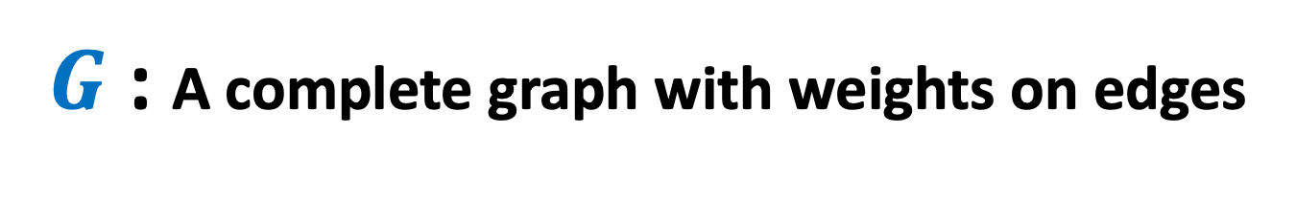


$G$ : A complete graph with weights on edges
Triangle inequality holds
TSP
Minimum Spanning Tree
A tour of least weight
A spanning tree of least weight.
A spanning tree of $G$
Cost of optimal TSP tour
$>MST(G)$
Cost of tour
$≤2 MST(G)$

Slide 9
Set Cover Problem

Slide 10


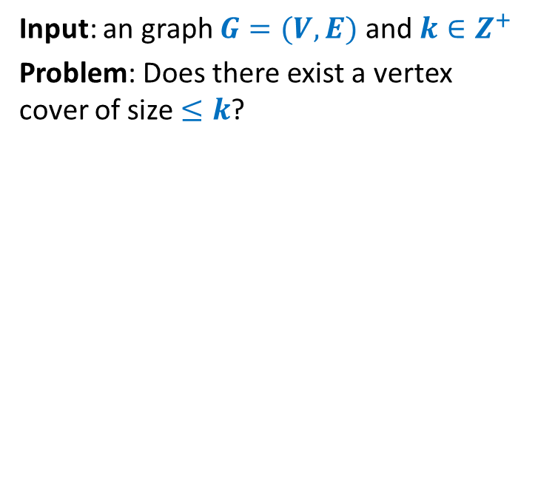







Set Cover Problem
a set $A$= {$e_{1}$, $e_{2}$,…,$e_{n}$}
$S_{1}$, $S_{2}$,…, $S_{k}$, with $S_{i}⊆A$
Optimization version: Compute least number of sets that can cover $A$.
Decision version: Does there exist $j$subsets that can cover all elements ?
$$e_{2}$$
$$e_{7}$$
$$e_{5}$$
$$e_{1}$$
$$e_{3}$$
$$e_{8}$$
$$e_{4}$$
$$e_{6}$$
$$e_{9}$$

Slide 11
Set Cover Problem
a set $A$= {$e_{1}$, $e_{2}$,…,$e_{n}$}
$S_{1}$, $S_{2}$,…, $S_{k}$, with $S_{i}⊆A$
Optimization version: Compute least number of sets that can cover $A$.
Decision version: Does there exist $j$subsets that can cover all elements ?
$$e_{2}$$
$$e_{7}$$
$$e_{5}$$
$$e_{1}$$
$$e_{3}$$
$$e_{8}$$
$$e_{4}$$
$$e_{6}$$
$$e_{9}$$

Slide 12
Set Cover Problem
a set $A$= {$e_{1}$, $e_{2}$,…,$e_{n}$}
$S_{1}$, $S_{2}$,…, $S_{k}$, with $S_{i}⊆A$
Optimization version: Compute least number of sets that can cover $A$.
Decision version: Does there exist $j$subsets that can cover all elements ?
$$e_{2}$$
$$e_{7}$$
$$e_{5}$$
$$e_{1}$$
$$e_{3}$$
$$e_{8}$$
$$e_{4}$$
$$e_{6}$$
$$e_{9}$$

Slide 13
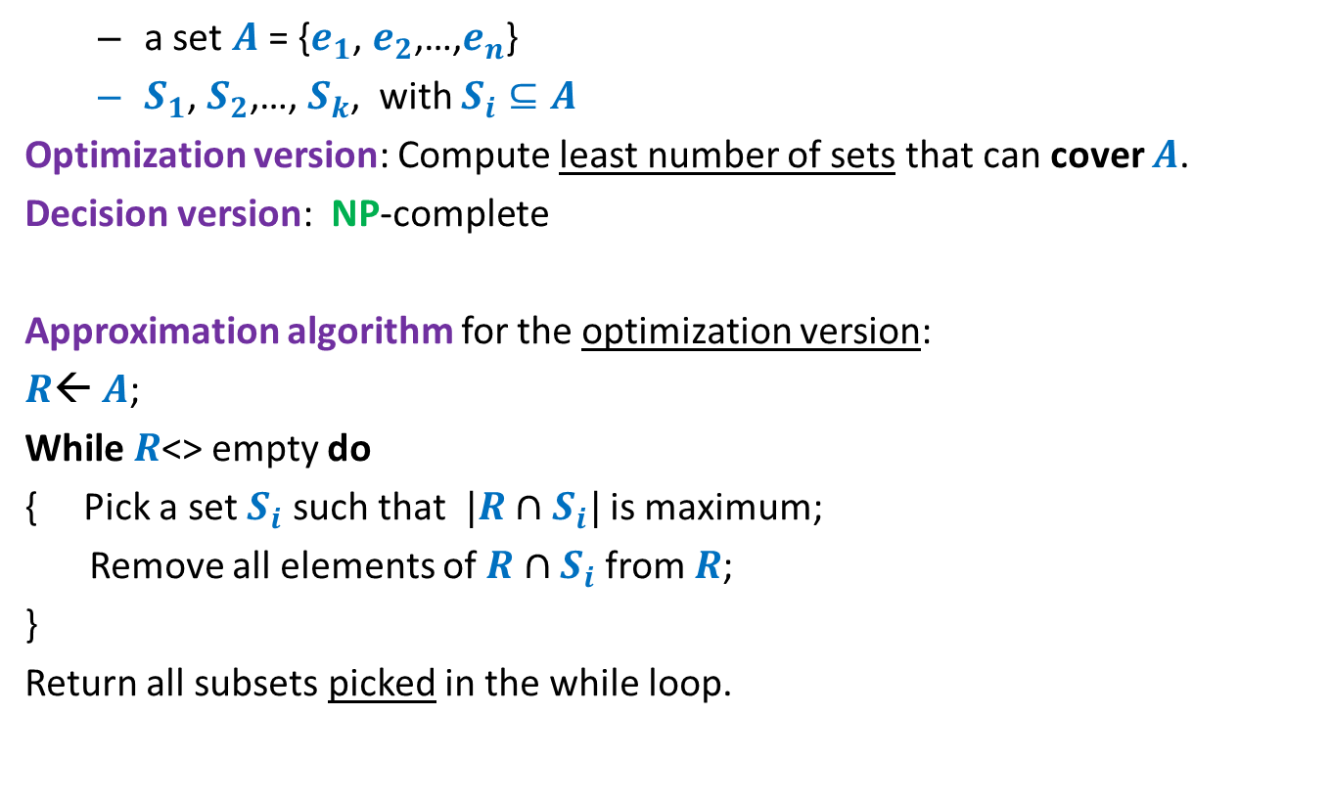
Set Cover Problem
a set $A$= {$e_{1}$, $e_{2}$,…,$e_{n}$}
$S_{1}$, $S_{2}$,…, $S_{k}$, with $S_{i}⊆A$
Optimization version: Compute least number of sets that can cover $A$.
Decision version: NP-complete
Approximation algorithm for the optimization version:
$R$← $A$;
While $R$<> empty do
{ Pick a set $S_{i}$ such that $|R∩S_{i}|$ is maximum;
Remove all elements of $R∩S_{i}$ from $R$;
}
Return all subsets picked in the while loop.
Homework
Think simple.
Follow your intuition

Slide 14





Optimality of the Greedy algorithm
a set $A$= {$e_{1}$, $e_{2}$,…,$e_{n}$}
$S_{1}$, $S_{2}$,…, $S_{k}$, with $S_{i}⊆A$
$$e_{8}$$
$$e_{2}$$
$$e_{7}$$
$$e_{5}$$
$$e_{9}$$
$$e_{1}$$
$$e_{3}$$
$$e_{6}$$
$$e_{4}$$

Slide 15
Optimality of the Greedy algorithm
a set $A$= {$e_{1}$, $e_{2}$,…,$e_{n}$}
$S_{1}$, $S_{2}$,…, $S_{k}$, with $S_{i}⊆A$
$$e_{8}$$
$$e_{2}$$
$$e_{7}$$
$$e_{5}$$
$$e_{9}$$
$$e_{1}$$
$$e_{3}$$
$$e_{6}$$
$$e_{4}$$

Slide 16
Optimality of the Greedy algorithm
a set $A$= {$e_{1}$, $e_{2}$,…,$e_{n}$}
$S_{1}$, $S_{2}$,…, $S_{k}$, with $S_{i}⊆A$
$$e_{8}$$
$$e_{2}$$
$$e_{7}$$
$$e_{5}$$
$$e_{9}$$
$$e_{1}$$
$$e_{3}$$
$$e_{6}$$
$$e_{4}$$

Slide 17

Optimality of the Greedy algorithm
a set $A$= {$e_{1}$, $e_{2}$,…,$e_{n}$}
$S_{1}$, $S_{2}$,…, $S_{k}$, with $S_{i}⊆A$
Greedy solution has $3$ sets
$$e_{8}$$
$$e_{2}$$
$$e_{7}$$
$$e_{5}$$
$$e_{9}$$
$$e_{1}$$
$$e_{3}$$
$$e_{6}$$
$$e_{4}$$

Slide 18




Optimality of the Greedy algorithm
a set $A$= {$e_{1}$, $e_{2}$,…,$e_{n}$}
$S_{1}$, $S_{2}$,…, $S_{k}$, with $S_{i}⊆A$
➔ Approx. ratio for this instance:
$$3/2$$
Greedy solution has $3$ sets
What is the worst case approx. ratio guaranteed for every possible instance ?
Optimal solution has $2$ sets
$$e_{8}$$
$$e_{2}$$
$$e_{7}$$
O($log n$)
$$e_{5}$$
$$e_{9}$$
$$e_{1}$$
$$e_{3}$$
$$e_{6}$$
$$e_{4}$$
We shall establish this approx. ratio for even the generic problem.

Slide 19

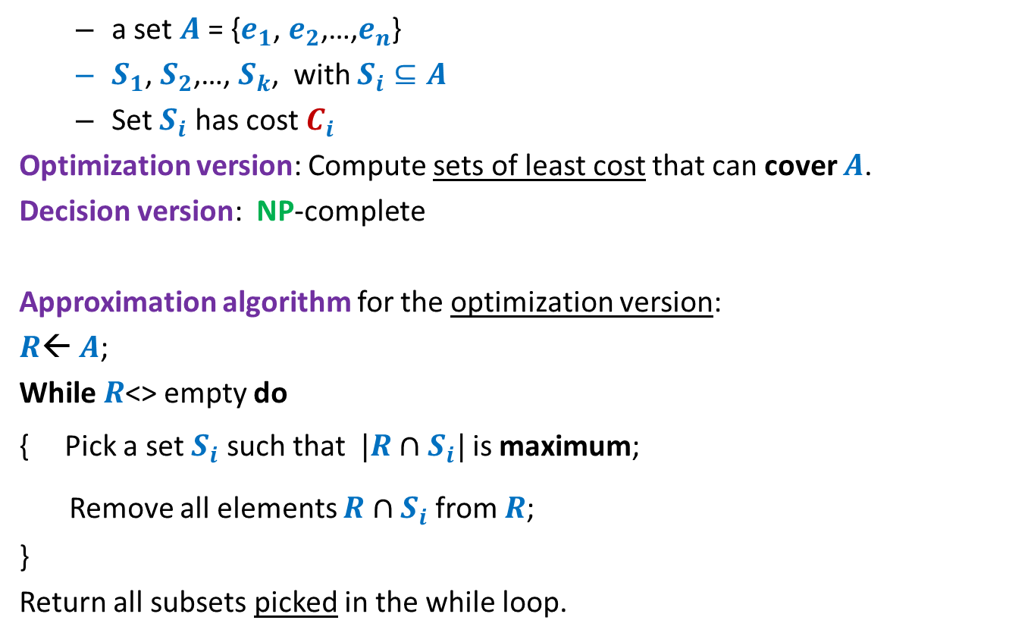

Set Cover Problem
Generic
a set $A$= {$e_{1}$, $e_{2}$,…,$e_{n}$}
$S_{1}$, $S_{2}$,…, $S_{k}$, with $S_{i}⊆A$
Set $S_{i}$ has cost $C_{i}$
Optimization version: Compute sets of least cost that can cover $A$.
Decision version: NP-complete
Approximation algorithm for the optimization version:
$R$← $A$;
While $R$<> empty do
{ Pick a set $S_{i}$ such that $|R∩S_{i}|$ is maximum;
Remove all elements $R∩S_{i}$ from $R$;
}
Return all subsets picked in the while loop.
$$\frac{|R∩S_{i}|}{C_{i}}$$
$$\frac{C_{i}}{|R∩S_{i}|}$$
is minimum;

Slide 20
How to analyze the greedy algorithm ?
The challenge:
No knowledge of the optimal solution.
Aim to get a worst case guarantee for all possible instances.
Conquering the challenge:
Pick any arbitrary instance
“Compare” greedy solution with its optimal solution.

Slide 21













How to analyze the greedy algorithm ?
Question: How to account for the sets $s_{2}$, $s_{6}$, $s_{11}$in the greedy algorithm ?
the sets belonging to “Optimal” solution
Optimal solution
$$s_{1}$$
$$s_{2}$$
$$s_{3}$$
$$s_{4}$$
$$s_{5}$$
$$s_{6}$$
$$s_{7}$$
$$s_{8}$$
$$s_{9}$$
$$s_{10}$$
$$s_{11}$$
$$s_{12}$$
Greedy solution
but absent in “Greedy” solution

Slide 22
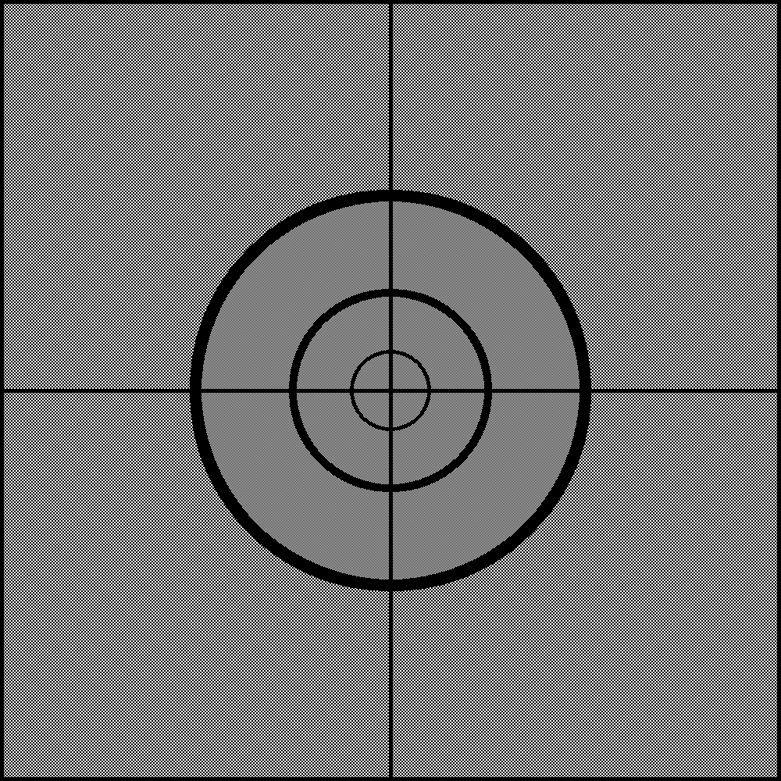
How to analyze the greedy algorithm ?
The key to analysis :
Cost of Sets
Cost of Elements

Slide 23

















Cost of each set ➔ cost of each element
Cost
Sets
Elements
$$e_{1}$$
$C_{1}$= $5$
$$s_{1}$$
$$e_{2}$$
$$e_{3}$$
$C_{2}$= $8$
$$s_{2}$$
$$e_{4}$$
$$e_{5}$$
$C_{3}$= $7$
$$s_{3}$$
$$e_{6}$$
$$e_{7}$$
$$e_{8}$$
$C_{4}$= $11$
$$s_{4}$$
$$e_{9}$$

Slide 24









Cost of each set ➔ cost of each element
Viewing any algorithm
Sum of cost of sets selected = sum of cost paid for each element.
Greedy algorithm: Select the set with ?
Cost
Sets
Elements
Cost/element
$$e_{1}$$
$$\frac{5}{4}$$
$C_{1}$= $5$
$$s_{1}$$
$$e_{2}$$
$$\frac{5}{4}$$
$$e_{3}$$
$$\frac{5}{4}$$
$C_{2}$= $8$
$$s_{2}$$
$$e_{4}$$
$$\frac{5}{4}$$
$$e_{5}$$
$$4$$
$C_{3}$= $7$
$$s_{3}$$
$$e_{6}$$
$$4$$
$$e_{7}$$
$$\frac{7}{3}$$
$$e_{8}$$
$$\frac{7}{3}$$
$C_{4}$= $11$
$$s_{4}$$
$$e_{9}$$
$$\frac{7}{3}$$
least cost per element

Slide 25



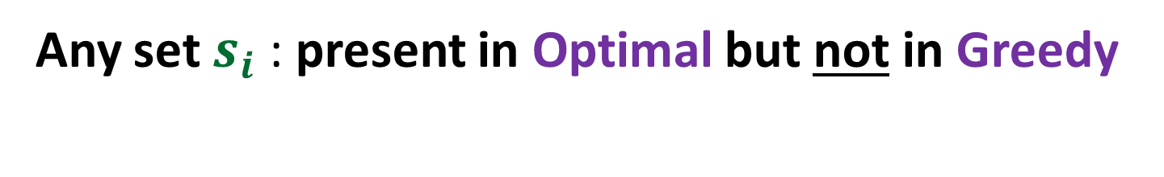
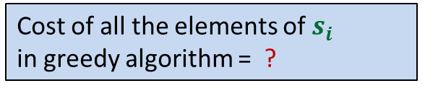


Any set $s_{i}$ : present in Optimal but not in Greedy
Cost =$C_{i}$
$$s_{i}$$
$|s_{i}|$ =$m_{i}$
Cost of these elements
in optimal algorithm = ?
Cost of all the elements of $s_{i}$
in greedy algorithm = ?
Cost of these elements
in greedy algorithm = ?
$$C_{i}$$
$${≤C}_{i} log m_{i}$$

Slide 26
We shall continue from here in the final class.

